Slide 1
Introduction to Global Health
Dr Yoga Nathan
Senior Lecturer in Public Health
GEMS UL

Slide 2
Learning Objective
To understand the link between water, sanitation and health from a global perspective.
To understand the environmental, social, economic and political factors playing a role in cholera.

Slide 3
Definition
What is global health?
  Health problems, issues, and concerns that transcend national boundaries, which may be influenced by circumstances or experiences in other countries, and which are best addressed by cooperative actions and solutions (Institute Of Medicine, USA- 1997)
Notes:
Examples include infectious diseases (SARS, TB, avian influenza, malaria,) non infectious diseases (diabetes mellitus, tobacco related diseases) and other health risks (global warming, conflict, nuclear power) etc.

Slide 4
Global Health Issues
Refers to any health issue that concerns many countries or is affected by transnational determinants such as:
  Climate change
  Urbanisation
  Malnutrition – under or over nutrition
  Or solutions such as:
  Polio eradication
  Containment of avian influenza
  Approaches to tobacco control

Slide 5
Historical Development of Term
Public Health: Developed as a discipline in the mid 19th century in UK, Europe and US. Concerned more with national issues.
  Data and evidence to support action, focus on populations, social justice and equity, emphasis on preventions vs cure.
International Health: Developed during past decades, came to be more concerned with
  the diseases (e.g. tropical diseases) and
  conditions (war, natural disasters) of middle and low income countries.
  Tended to denote a one way flow of ‘good ideas’.
Global Health: More recent in its origin and emphasises a greater scope of health problems and solutions
  that transcend national boundaries
  requiring greater inter-disciplinary approach

Slide 6
Disciplines involved in Global Health
Social sciences
Behavioural sciences
Law
Economics
History
Engineering
Biomedical sciences
Environmental sciences

Slide 7
Communicable Diseases and Risk Factors
Infectious diseases are communicable
But..
so are elements of western lifestyles:
  Dietary changes
  Lack of physical activity
  Reliance on automobile transport
  Smoking
  Stress
  Urbanisation

Slide 8



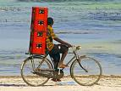


It’s the Real Thing

Slide 9
Key Concepts in Relation to Global Health
The determinants of health
The measurement of health status
The importance of culture to health
The global burden of disease
The key risk factors for various health problems
The organisation and function of health systems

Slide 10
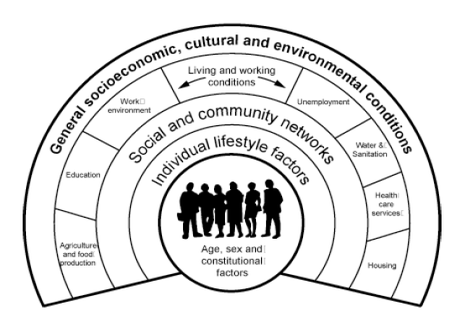
1. Determinants of Health
Genetic make up
Age
Gender
Lifestyle choices
Community influences
Income status
Geographical location
Culture
Environmental factors
Work conditions
Education
Access to health
services
Source: Dahlgren G. and Whitehead M. 1991

Slide 11
Determinants of Health
PLUS MORE GENERAL FACTORS SUCH AS:
POLITICAL STABILITY
CIVIL RIGHTS
ENVIRONMENTAL DEGRADATION
POPULATION GROWTH/PRESSURE
URBANISATION
DEVELOPMENT OF COUNTRY OF RESIDENCE

Slide 12
Multi-sectoral Dimension of the Determinants of Health
Malnutrition –
  more susceptible to disease and less likely to recover
Cooking with wood and coal –
  lung diseases
Poor sanitation –
  more intestinal infections
Poor life circumstances –
  commercial sex work and STIs, HIV/AIDS
Advertising tobacco and alcohol –
  addiction and related diseases
Rapid growth in vehicular traffic often with untrained drivers on unsafe roads-
  road traffic accidents

Slide 13
2. The Measurement of Health Status I
Cause of death
  Obtained from death certification but limited because of incomplete coverage
Life expectancy at birth
  The average number of years a new-borns baby could expect to live if current trends in mortality were to continue for the rest of the new-born's life
Maternal mortality rate
  The number of women who die as a result of childbirth and pregnancy related complications per 100,000 live births in a given year

Slide 14
The Measurement of Health Status II
Infant mortality rate
  The number of deaths in infants under 1 year per 1,000 live births for a given year
Neonatal mortality rate
  The number of deaths among infants under 28 days in a given year per 1,000 live births in that year
Child mortality rate
  The probability that a new-born will die before reaching the age of five years, expressed as a number per 1,000 live births

Slide 15
3. Culture and Health
Culture:
  The predominating attitudes and behaviour that characterise the functioning of a group or organisation
Traditional health systems
Beliefs about health
  e.g. epilepsy – a disorder of neuronal depolarisation vs a form of possession/bad omen sent by the ancestors
  Psychoses – ancestral problems requiring the assistance of traditional healer/spiritualist
Influence of culture of health
  Diversity, marginalisation and vulnerability due to race, gender and ethnicity

Slide 16
4. The global burden of disease
Predicted changes in burden of disease from communicable to non-communicable between 2004 and 2030
  Reductions in malaria, diarrhoeal diseases, TB and HIV/AIDS
  Increase in cardiovascular deaths, COPD, road traffic accidents and diabetes mellitus
Ageing populations in middle and low income countries
Socioeconomic growth with increased car ownership
Based on a ‘business as usual’ assumption

Slide 17
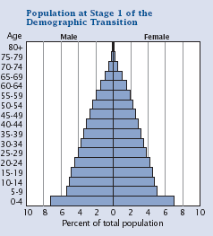
High Fertility/High Mortality
Source: US Census Bureau, Population Report

Slide 18
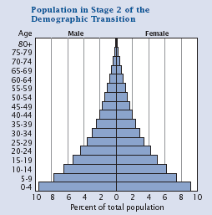
Declining Mortality/High Fertility
Source: US Census Bureau, Population Report

Slide 19
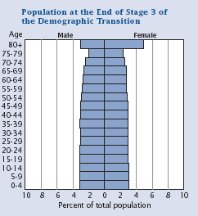
Reduced Fertility/Reduced Mortality
Source: US Census Bureau, Population Report

Slide 20
5. Key Risk Factors for Various Health Conditions
Tobacco use –
  related to the top ten causes of mortality world wide
Poor sanitation and access to clean water-
  related to high levels of diarrhoeal/water borne diseases
Low condom use –
  HIV/AIDS, sexually transmitted infections
Malnutrition –
  Under-nutrition (increased susceptibility to infectious diseases) and over-nutrition responsible for cardiovascular diseases, cancers, obesity etc.
Notes:
Diarrhoea contributes to about 1·5 million child deaths and around 88% of deaths from diarrhoea

Slide 21
6. The Organisation and Function of Health Systems
A health system
  comprises all organizations, institutions and resources devoted to producing actions whose primary intent is to improve health (WHO)
Most national health systems consist:
  public, private,
  traditional and informal sectors:

Slide 22
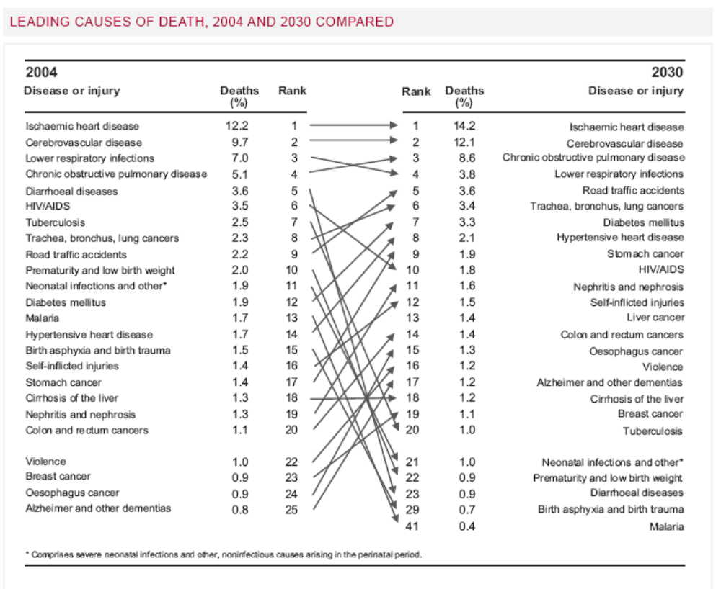
Source: WHO statistics 2008
Source: W.H.O. Statistics

Slide 23
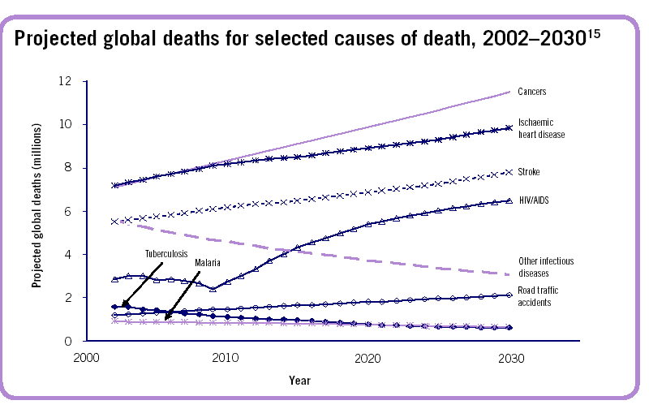
Trends in Global Deaths 2002-30
Source: World Health Statistics 2007
Notes:
The upward trend in HIV/AIDS mortality and downward trend in RTIs and other infectious diseases will place HIV/AIDS as the top ranking cause of death from infectious diseases before 2020

Slide 24
COMPARATIVE DATA (1)
IRELAND DEVELOPING COUNTRIES
INFANT MORTALITY 7 100-190
RATE
UNDER 5 MORTALITY 10 175-300
RATE
MATERNAL MORTALITY 2 600-1600
RATE
LIFE EXPECTANCY F - 82 F < 50
M - 77 M < 50
but may be
= or > F

Slide 25
COMPARATIVE DATA (2)
IRELAND DEVELOPING COUNTRIES
POPULATION GROWTH 0.3% 3%+
RATE
HIV +ve RATE 0.15% 15%+
AIDS CASES 20/ 400/
100,000 100,000
GNP PER CAPITA $16,000 <$200
HEALTH EXPENDITURE $1,600 $1-$2
PER CAPITA

Slide 26
HEALTH PATTERNS
GENETIC FACTORS
ENVIRONMENTAL FACTORS
LIFESTYLE FACTORS
COMMUNICABLE vs NON-COMMUNICABLE
DISEASES DISEASES

Slide 27
HEALTH PATTERNS IN
RESOURCE POOR COUNTRIES
INFECTIOUS/COMMUNICABLE DISEASES PREVALENT:
VACCINE PREVENTABLE DISEASES, e.g. measles
ACUTE RESPIRATORY INFECTIONS (ARI)
DIARRHOEAL DISEASES (cholera)
MALARIA
TB
HEPATITIS
HIV/AIDS
Plus:
MALNUTRITION RELATED CONDITIONS:
- CALORIE DEFICIENCIES
- MICRO-NUTRIENT DEFICIENCIES
TRAUMA/ACCIDENTS
Many of these diseases are treatable

Slide 28
HEALTH PATTERNS IN
RESOURCE RICH COUNTRIES
NON-COMMUNICABLE DISEASES PREVALENT:
Causes of death (all ages):
40% Circulatory diseases, e.g. heart disease, strokes, etc.
25% Cancers
16% Respiratory diseases
5% Injuries and Poisonings
0.6% Infectious diseases
Premature mortality (<65):
25% Circulatory diseases
33% Cancers
16% Injuries (RTAs/Suicides) and Poisonings
1% Infectious diseases
Many of these deaths are related to lifestyle factors and are preventable

Slide 29
HEALTH PATTERNS IN RESOURCE RICH COUNTRIES
Lifestyle factors affecting physical and mental health:
Smoking – one third of cancer deaths related to smoking
Drinking
Healthy eating/nutrition
Physical activity
Substance abuse

Slide 30
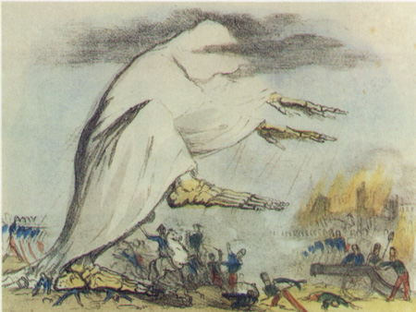
Cholera 1800s

Slide 31
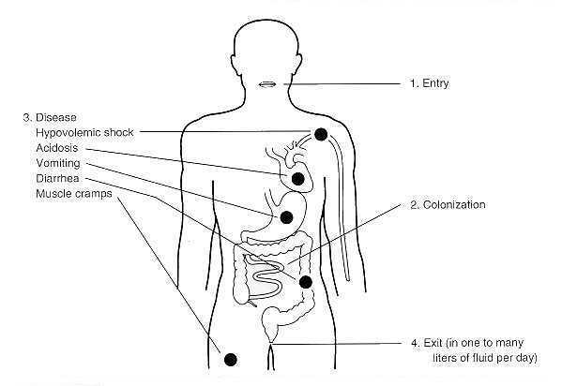
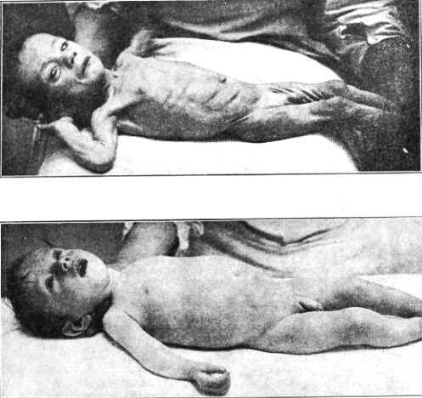
Cholera: the Disease
Entry: oral
Colonization: small intestine
Symptoms: nausea, diarrhea, muscle cramps, shock
Infants with cholera

Slide 32
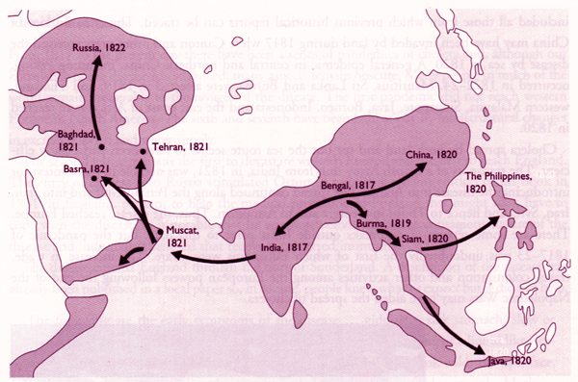
First Cholera Pandemic

Slide 33
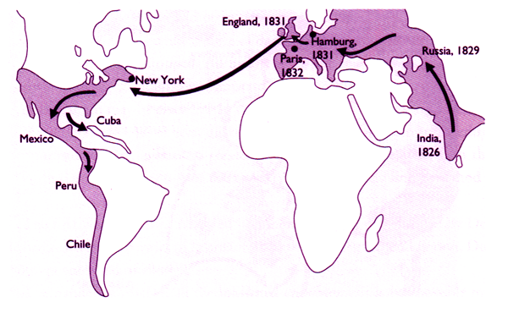
Second Cholera Pandemic

Slide 34
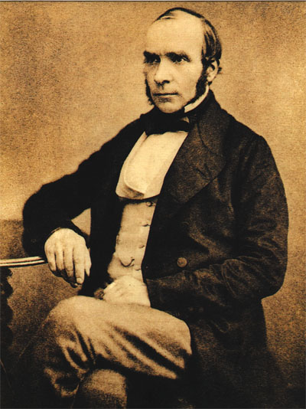

John Snow and the Pump Handle
John Snow is credited by many with developing the modern field of epidemiology
John Snow and cholera in 1854 London http://www.ph.ucla.edu/epi/snow.html

Slide 35
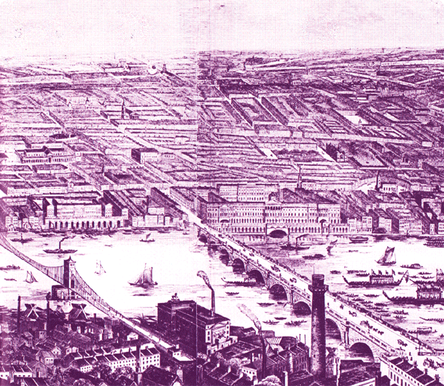
London in the 1850’s
  Germ theory of disease not widely accepted
People lived in very crowded conditions with water and privies in yard (NY 1864: 900 people in 2 buildings 180’ deep x 5 stories – 1 pump a block away, privy in yard)

Slide 36
John Snow’s Observations
People with cholera developed immediate digestive problems: cramps, vomiting, diarrhea
Face, feet, hands shriveled and turned blue; died in less than a day
Probably spread by vomiting and diarrhea
Comparison of pump location with cholera deaths, first 3 days of epidemic in 1854

Slide 37
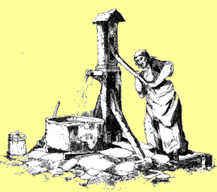
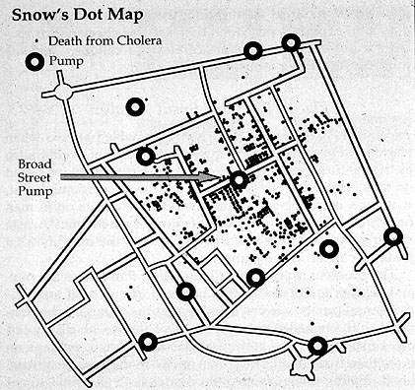
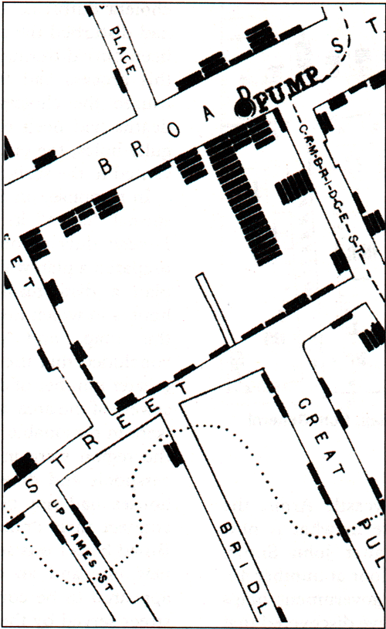
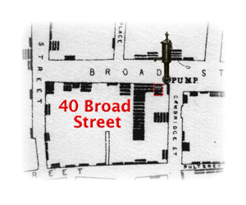
Water Supply London 1850’s

Slide 38
Cholera Epidemiology
Of 83 people, only 10 lived closer to a different pump than Broad Street
Of these 10, 5 preferred taste of Broad Street water and 3 were children who went to nearby school

Slide 39
Snow Index Case
Index case is first person to become ill
40 Broad Street – husband and infant child became ill
Wife soaked diapers in pail and emptied pail into cistern next to pump

Slide 40
The Great Experiment
Two water companies supplied central London
Lambeth Company: water intake upstream of London sewage outfall into Thames
Southwark & Vauxhall Company: water intake downstream of sewage outfall

Slide 41
The Great Experiment
Customers mixed in same neighborhood
Snow went door to door asking which water company served home and compared locations with cholera data

Slide 42
The Great Experiment
 | # Houses | # Deaths | Deaths/ 100,000
S and V | 40,046 | 1263 | 315
Lambeth | 26,107 | 98 | 37

Slide 43
Cholera Epidemiology
Snow convinced neighborhood council to let him remove handle from water pump on Broad Street
The new cases declined dramatically
Many on council not convinced by his evidence

Slide 44
Cholera in the 1990s
Epidemic in Peru beginning 1991
From 1991-1994
  Cases 1,041,422
  Deaths 9,642 (0.9%)
Originated at coast, spread inland

Slide 45
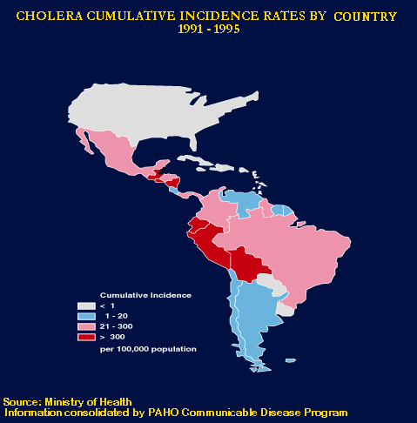

Slide 46
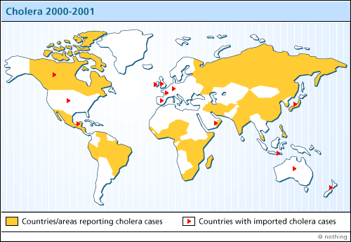
World Cholera 2000-01

Slide 47
Why Has Cholera Re-emerged?
Deteriorating sanitary facilities as larger population moves into shanty towns
Trujullo, Peru – fear of cancer from chlorination so water untreated
Use of wastewater on crops
Africa – civil wars and drought caused migrations into camps

Slide 48
How Has Cholera Re-emerged?
Simultaneous appearance along whole coast of Peru
Traveled in ship ballast?
Traveled in plankton from Asia?
Always present in local zooplankton (copepods) but dormant until triggered by ???

Slide 49
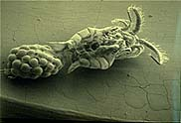
Copepod Carrying Vibrio cholerae

Slide 50
Global Health References
Skolnik R. Essentials of Global Health. Jones & Bartlett Publishers, Sudbury MA 2008. Chapter 1
Ed. Robert Beaglehole, 2003. Global Public Health: A new era. Chapter 1
Megan Landon. 2006. Environment, Health and Sustainable Development
Bonder, B. Martin L. Miracle A. Culture in Clinical Care
Koplan J et al, 2009. Towards a common definition of global health The Lancet, Volume 373, Issue 9679, Pages 1993-1995

